Slide 1
Student Result Analysis Using Python

Slide 2
Libraries Used
NumPy
Pandas
Matplotlib
Seaborn

Slide 3
Dataset Used

Slide 4
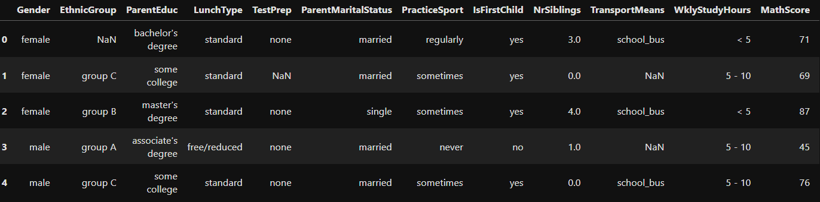
Dataset - Table

Slide 5
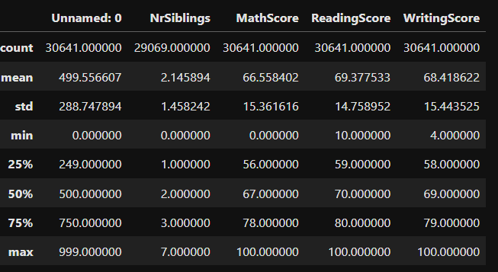
Dataset- Describe

Slide 6
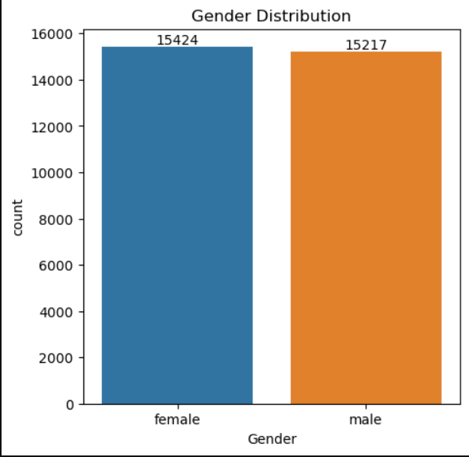
Gender Distribution

Slide 7
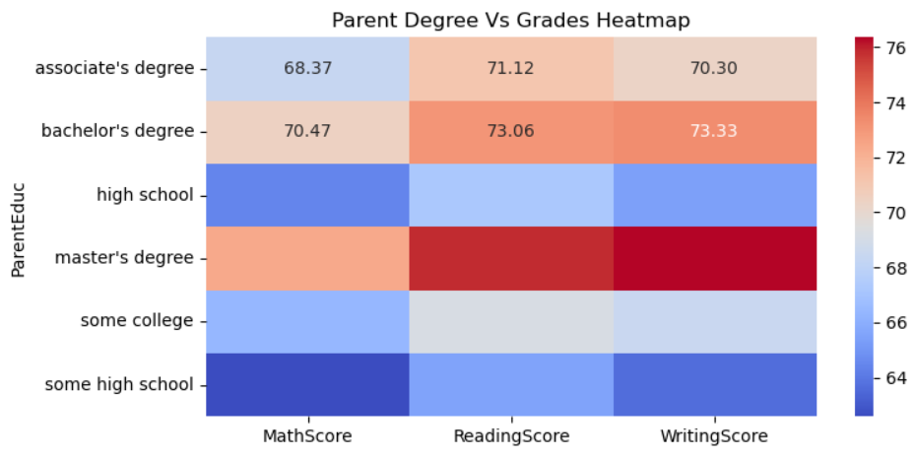
Parent Degree Vs Grades Heatmap

Slide 8
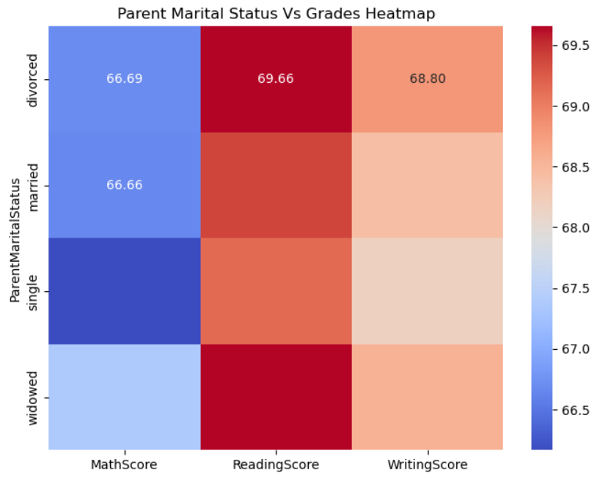
Parent Marital Status Vs Grades Heatmap

Slide 9
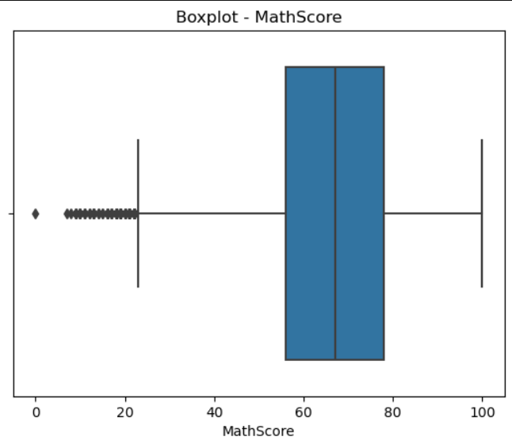
Boxplot – Math, Reading, Writing

Slide 10
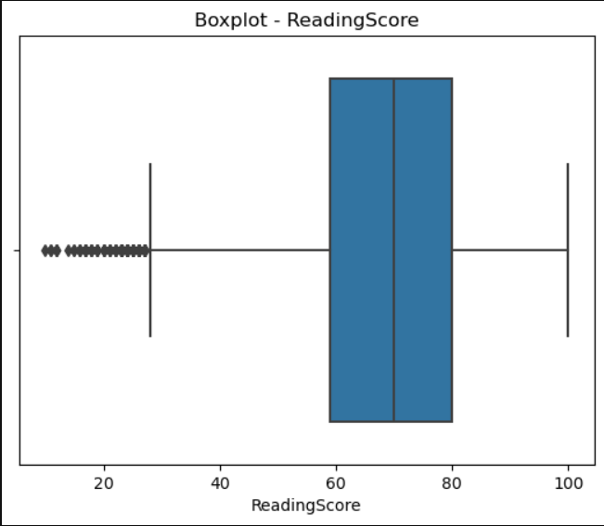
Boxplot – Math, Reading, Writing

Slide 11
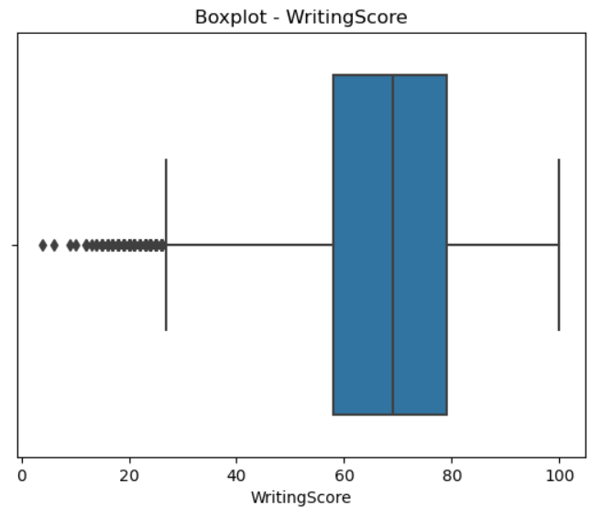
Boxplot – Math, Reading, Writing

Slide 12

Boxplot – Math, Reading, Writing

Slide 13
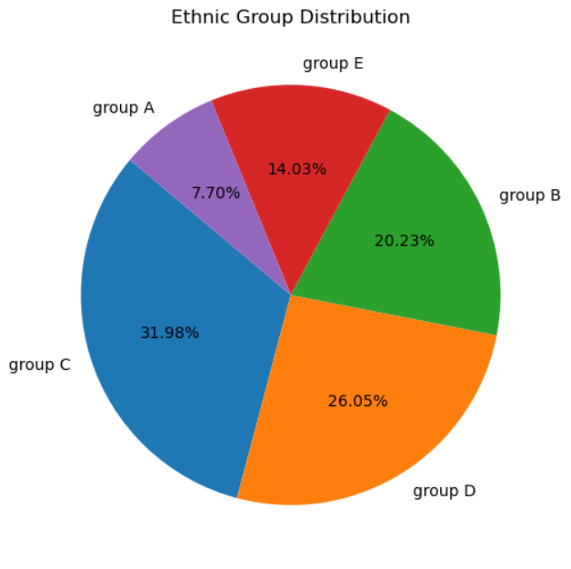
Distribution of Ethnic Groups

Slide 14
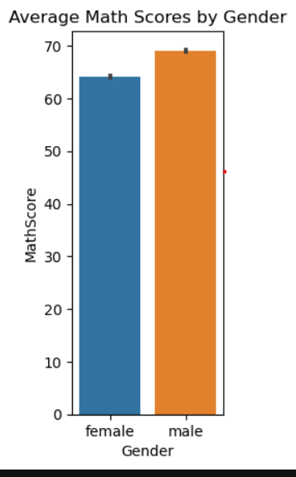
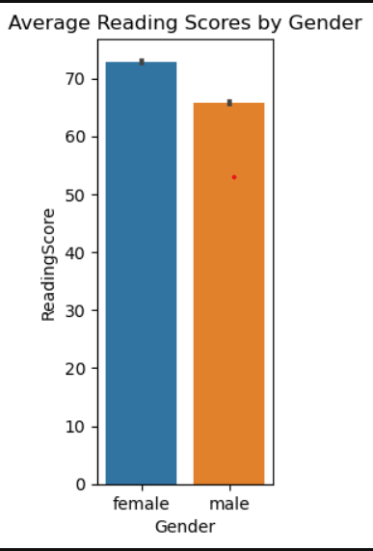
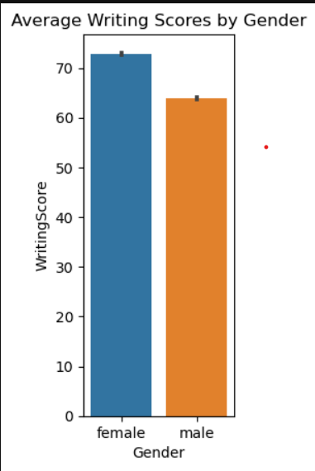
Descriptive Statistics by Gender

Slide 15
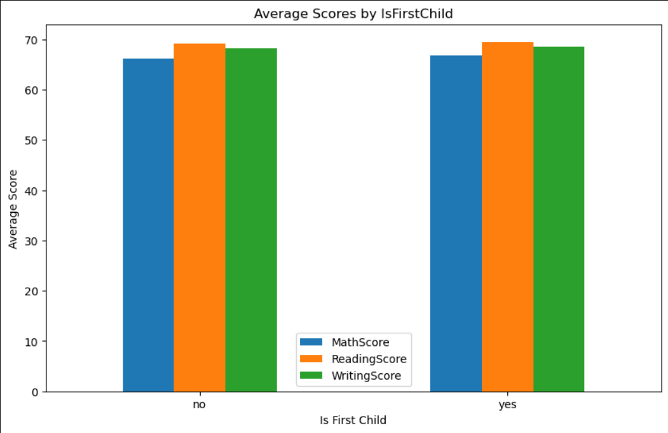
Average Scores if First Child 0r Not

Slide 16
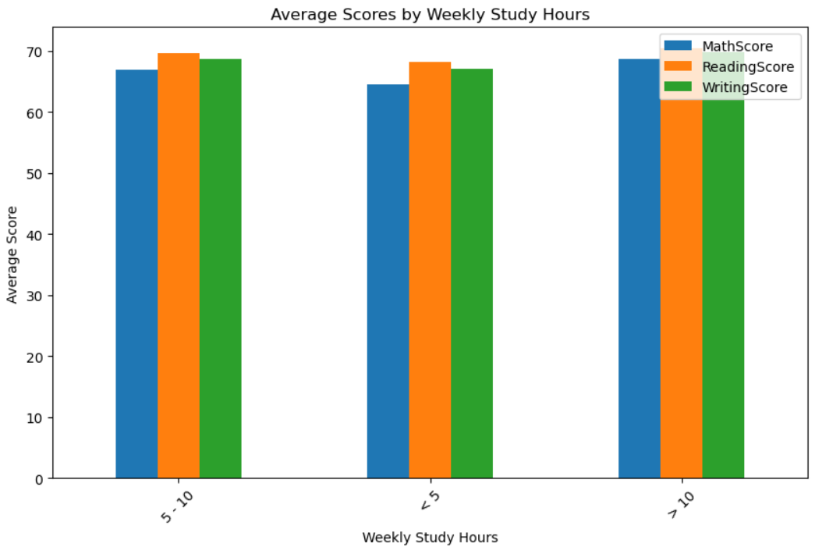
Average Scores based on weekly study hours

Slide 17
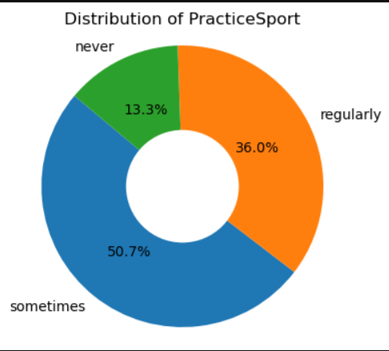
Distribution of Student Practicing Sports

Slide 18
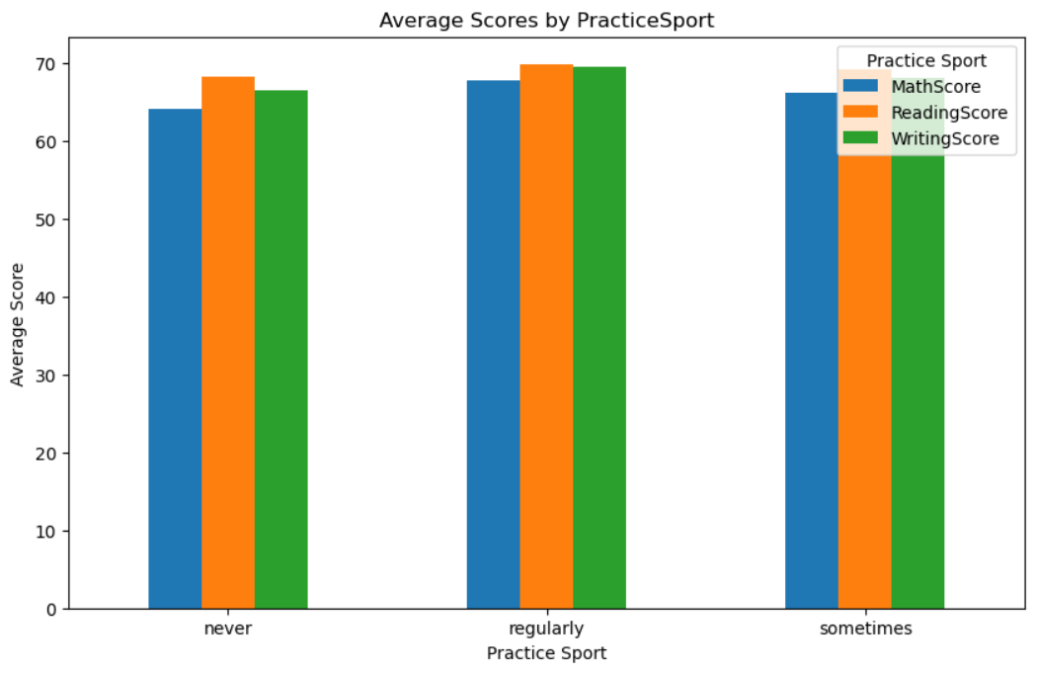
Average Score Analysis Based on Sport Practice

Slide 19
Thank You

